Slide 1




DIGITAL LITERACY
SKILLS
BASIC USERS

Slide 2
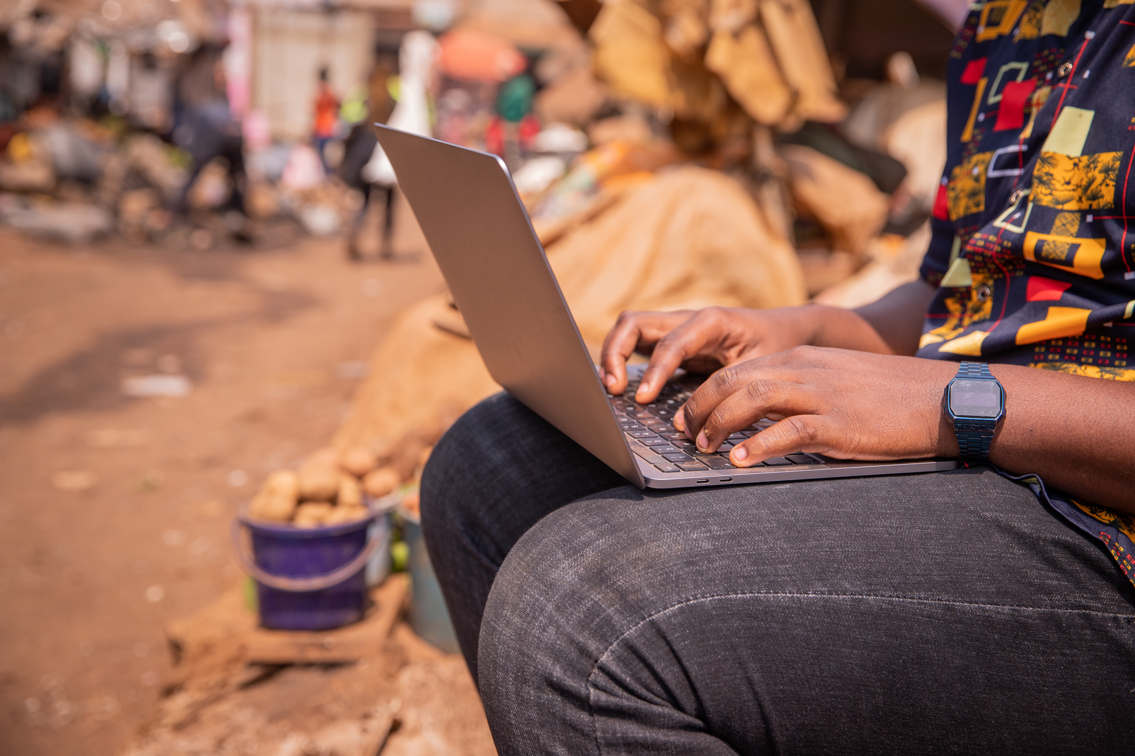
Module 3
Communication
and collaboration

Slide 3

5
Unit 5: Netiquette

Slide 4
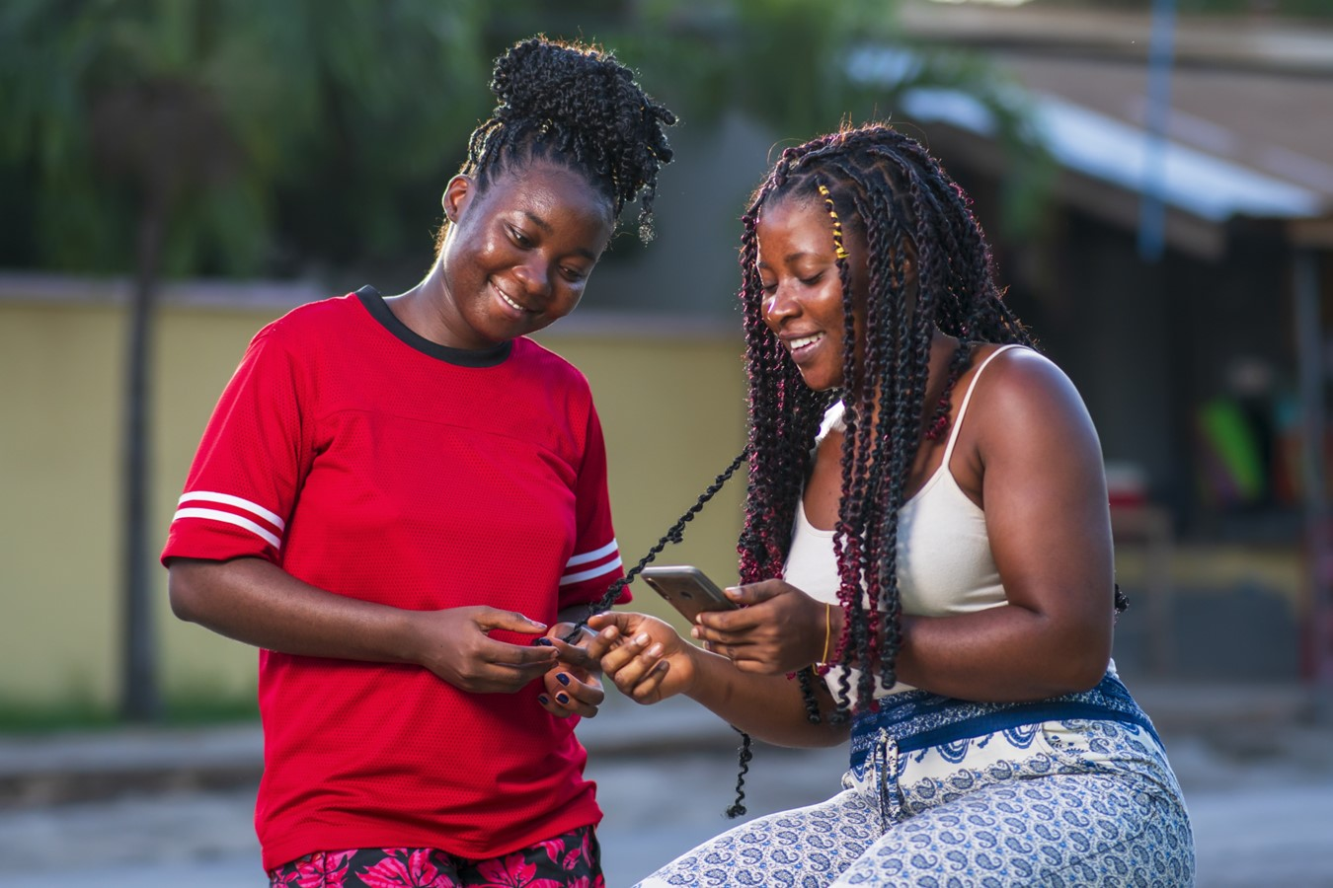
What does netiquette mean?
Netiquette is the online equivalent of etiquette. It is a way of behaving that respects and upholds the dignity and humanity of the people you are interacting with online.

Slide 5
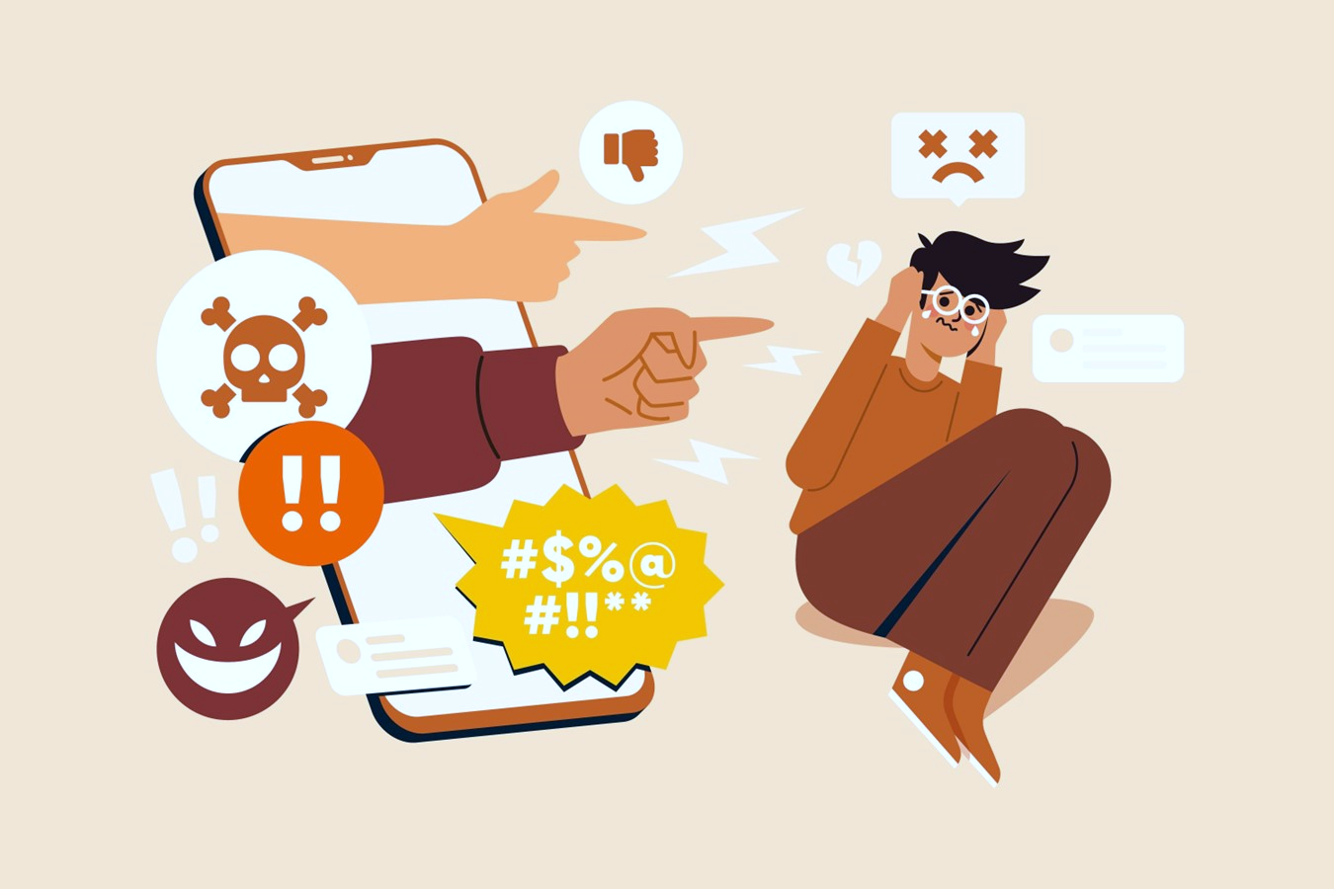
What to avoid when applying netiquette
Bad netiquette includes all online behaviours that are disrespectful towards others.

Slide 6
What to avoid when applying netiquette
Disrespecting intellectual property: Sharing content of others without citing the source.
Not respecting other people's opinions: Adopting hostile and insulting attitudes.
Expressing ourselves in a disrespectful way: When writing be aware of how you write and how you express yourself and your ideas.
Disrespecting the privacy of others: Never share sensitive data without the other person's permission.

Slide 7
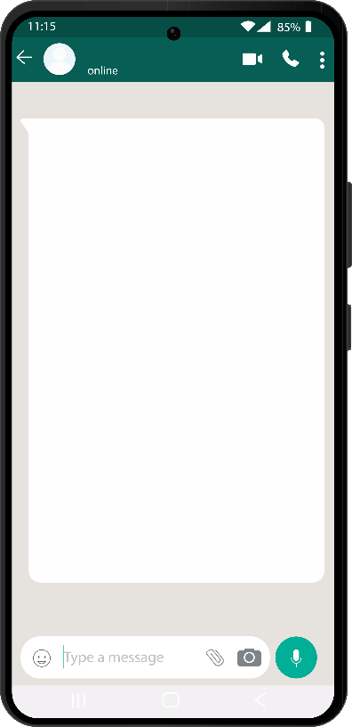

Skills to practise
Rules to follow when communicating digitally.
Write a list of rules that you will follow when using email, WhatsApp, or SMS. Say how you will:
not hurt people’s feelings
not share personal information
Adjust language.
Read this message.
How would you change the language in this message to make it more acceptable?
Dear Abbo
I think you @#^&!
You are ugly and you dress funny!
DON’T COME NEAR ME!
Continue >

Slide 8
Skills to practise
3. Make sure that posted content does not embarrass others.
Make a list of the things that you will not type in messages that will offend or embarrass others.
What type of photos would you NOT share with others as they could cause embarrassment?
List the type of information that you should NOT share with others because you or your friends could get into trouble.

Slide 9
All back covers should include
contact information of the section
producing the work.
© United Nations Children’s Fund (UNICEF) [month and year of publication]

